Slide 1

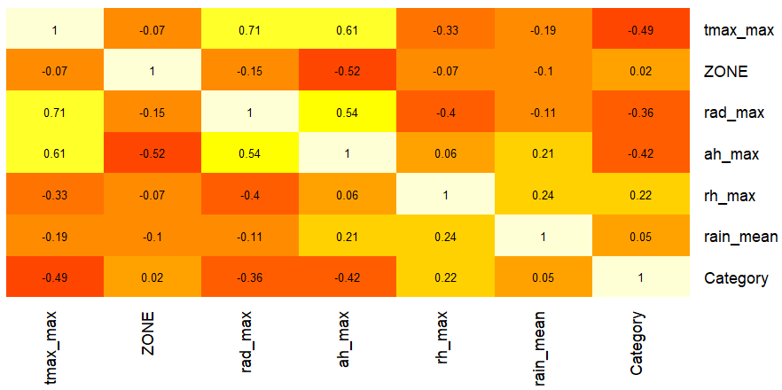
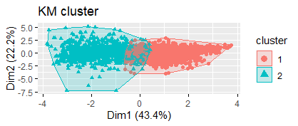
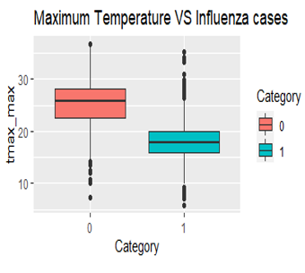
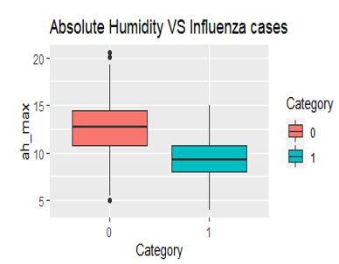
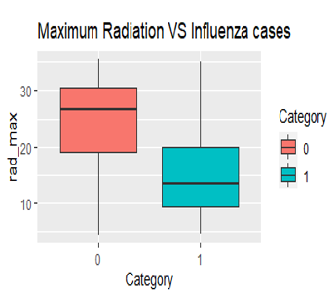


Predictive Modelling on Influenza
Project Team: Srinivas Baddam
Supervisor: Adrian Hargreaves
Client: Adrian Hargreaves
Semester 3, 2021
Background
Final Results
Methodology
This project is the first of its kind in New Zealand to use data mining techniques to analyse epidemiological and climatic data to produce a predictive model. Though there were a few studies previously undertaken on Influenza epidemics, our client would like to further investigate this area in the context of weather factors. understanding these factors that influence the rate of influenza hospitalisations will help doctors, DHBs, policy makers and the New Zealand government to be prepared to better manage the future Influenza hospitalizations
It is found that weather factors like temperature, solar radiation, and absolute humidity are significantly corelated to the rate of influenza hospitalizations in New Zealand.
This research identified largely noticeable differences between the number of Influenza cases in different zones of New Zealand.
There are two distinct groups found between the weather variables which affect the occurrence of Influenza cases in New Zealand.
Out of the five predictive models compared, this research suggests the Logistic Regression model is the best to predict the rate of Influenza hospitalizations with 89.02% predictive accuracy.
This project uses a method called Cross-industry standard process for data mining (CRISP-DM). This methodology provides a structured approach for planning a data mining project. It is a robust and well-proven methodology consists of six steps such as business understanding, data understanding, data preparation, modelling, evaluation, and deployment. Since the proposed project undergoes various phases such as data pre-processing, statistical analysis, and data modelling etc., CRISP-DM method will guide through the necessary phases to achieve the project objectives.
Objective
Technology
This project aims to address TWO research questions.
Determine what correlations exist between the variables within a data set provided by the Ministry of Health (MoH) as well as the correlations that may exist between the variables within the weather data provided by NIWA and MoH data.
Determine what data mining algorithm produces the best predictive model for determining the incidence of influenza hospitalizations in New Zealand based on the weather data from NIWA.
Recommendations for future development
Algorithm | Accuracy | P_Value | Sensitivity | Specificity | Postive Prediction Value | Negative Prediction Value | Balanced Accuracy
Logistic_Regression | 89.02% | 2.00E-16 | 87.17% | 90.55% | 88.35% | 89.57% | 88.86%
KNN | 87% | 2.00E-16 | 91.49% | 0.82% | 85.41% | 89.18% | 86.63%
CART | 83.29% | 2.00E-16 | 83.38% | 83.22% | 80.99% | 85.38% | 83.30%
Random_Forest | 86.54% | 2.00E-16 | 84.30% | 88.67% | 87.63% | 85.58% | 86.49%
Naive_Bayes | 84.16% | 2.00E-16 | 80.43% | 87.36% | 84.51% | 83.89% | 83.89%
This project could be further continued by incorporating the biological data of New Zealand population into the research. This will help improve the accuracy of the predictive models as the existing literature indicates that there is a strong correlation between Influenza rates and biological factors

